Slide 1
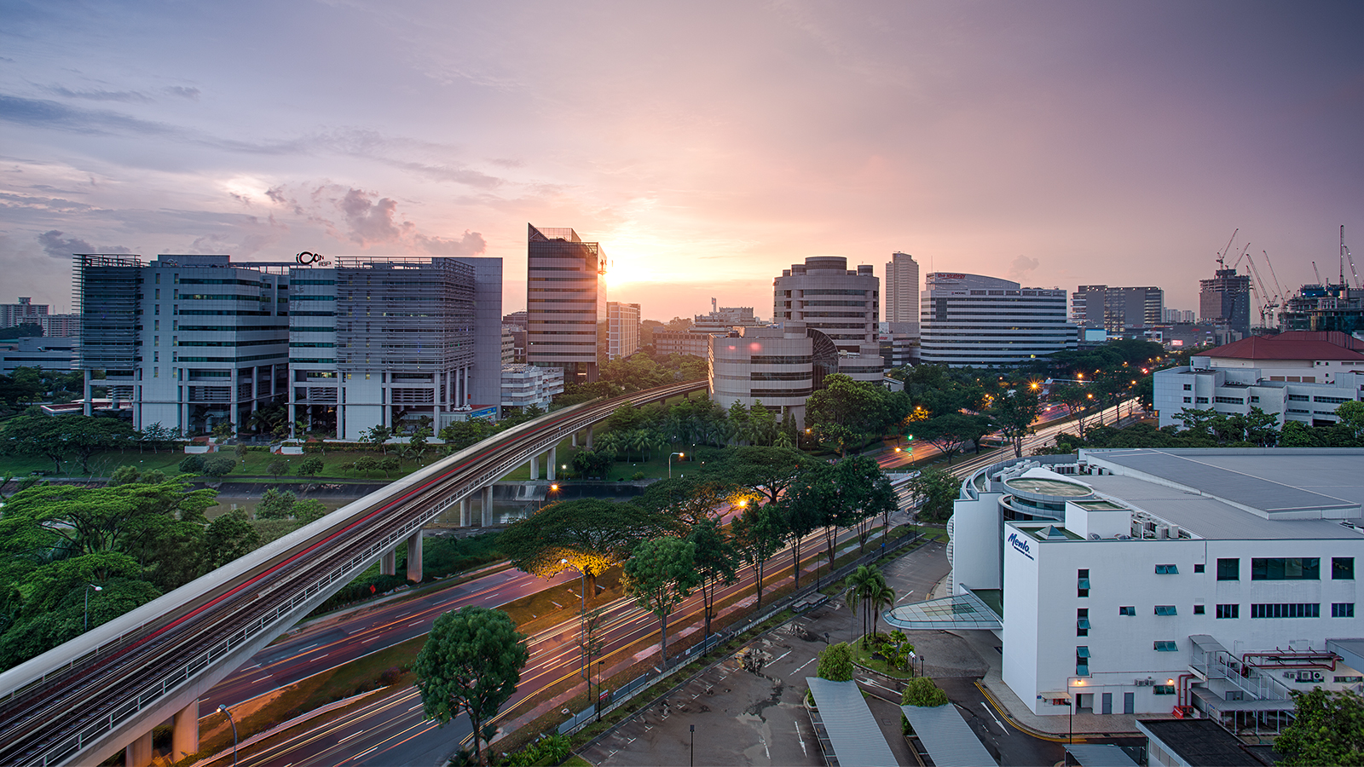
EI Project Demonstration: Public Transport System
Group 3
Eugene Choy Wen Jia Ho Min Kit Winston Ho Wei Hong Sim Li Jin Yin Yukun Yong Fu Xiang
Image retrieved from www.travelweekly-asia.com

Slide 2
Scenario
Public Transport network serves hundred of thousands of passengers everyday. Any disruption in the service would require mitigation actions to be taken to ensure minimal disruptions to the passengers.
A well-integrated public transport network across multiple systems with the various stakeholders will help enhance the communication and automate processes when mitigation actions are required

Slide 3
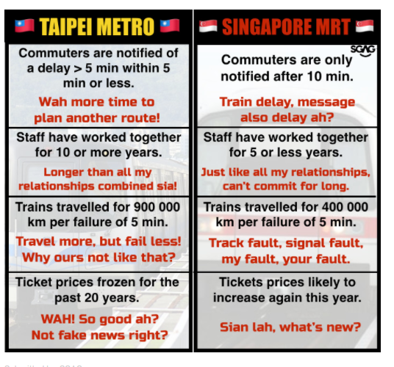
What motivates us?
"BRINGING YOU LATEST TRANSPORT UPDATE. EVEN FASTER THAN SMRT CORPORATION THROUGH INTEGRATION"

Slide 4
3 Key Processes
Train Breakdown and Resumption of Service
Weather Reporting
Schedule Polling

Slide 5

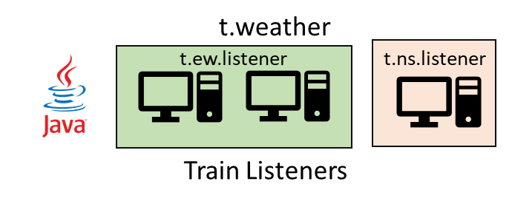
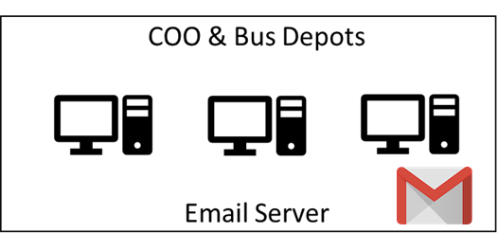

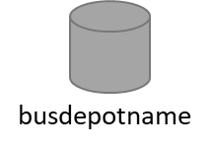
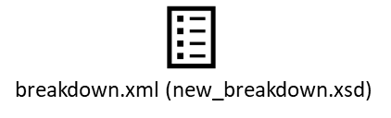



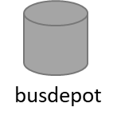
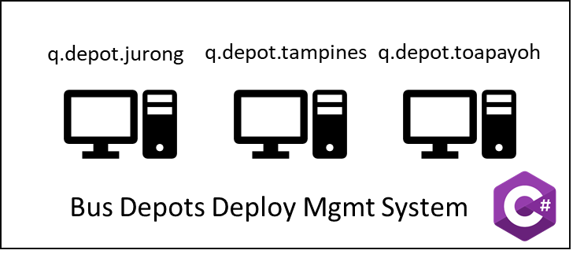


Break down messages
Heavy Rainfall Report
t.weather
t.<dynamic>.listener
Send Emails
jdbc
TIBCO BW
EMS
q.breakdown
q.deployed
q.depot.<dynamic>
t.weather
t.<dynamic>.listener
P q.breakdown (Q)
P q.deployed
C q.deployed (Q)
File Poller
busRequest.xml (new_busRequest.xsd)
Bus Management System
C q.depot.<dynamic>
HTTP
Breakdown_formatted.xml
(new_breakdown_formatted.xsd)
HTTP
HTTP

Slide 6
Train Breakdown and Resumption of Service Process

Slide 7
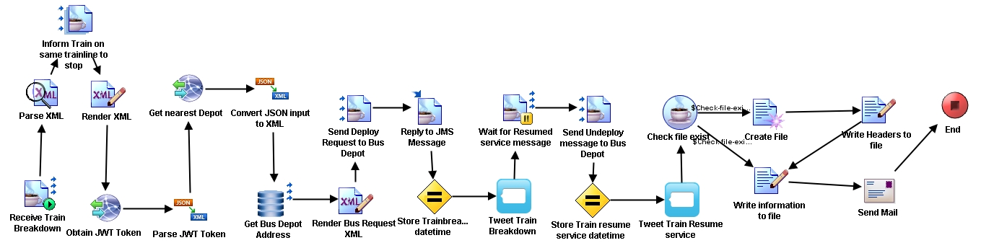
Train Breakdown
Resumption of Service

Slide 8
Break down messages
Heavy Rainfall Report
t.weather
t.<dynamic>.listener
Send Emails
jdbc
TIBCO BW
EMS
q.breakdown
q.deployed
q.depot.<dynamic>
t.weather
t.<dynamic>.listener
P q.breakdown (Q)
P q.deployed
C q.deployed (Q)
File Poller
busRequest.xml (new_busRequest.xsd)
Bus Management System
C q.depot.<dynamic>
HTTP
Breakdown_formatted.xml
(new_breakdown_formatted.xsd)
HTTP
HTTP

Slide 9

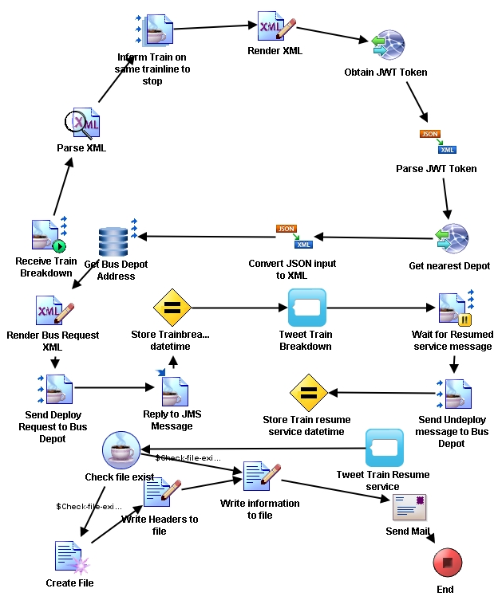

Slide 10
Weather Reporting Process

Slide 11
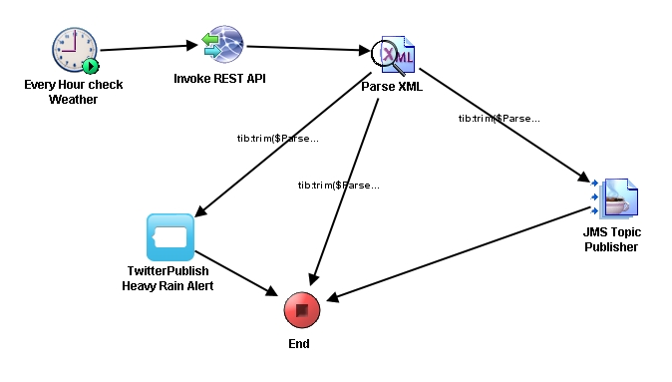

Slide 12
Break down messages
Heavy Rainfall Report
t.weather
t.<dynamic>.listener
Send Emails
jdbc
TIBCO BW
EMS
q.breakdown
q.deployed
q.depot.<dynamic>
t.weather
t.<dynamic>.listener
P q.breakdown (Q)
P q.deployed
C q.deployed (Q)
File Poller
busRequest.xml (new_busRequest.xsd)
Bus Management System
C q.depot.<dynamic>
HTTP
Breakdown_formatted.xml
(new_breakdown_formatted.xsd)
HTTP
HTTP

Slide 13
Schedule Polling Process

Slide 14
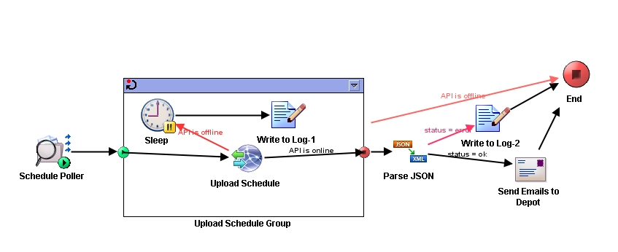

Slide 15

Break down messages
Heavy Rainfall Report
t.weather
t.<dynamic>.listener
Send Emails
jdbc
TIBCO BW
EMS
q.breakdown
q.deployed
q.depot.<dynamic>
t.weather
t.<dynamic>.listener
P q.breakdown (Q)
P q.deployed
C q.deployed (Q)
File Poller
busRequest.xml (new_busRequest.xsd)
C q.depot.<dynamic>
HTTP
Breakdown_formatted.xml
(new_breakdown_formatted.xsd)
HTTP
HTTP

Slide 16
Content Routing

Slide 17
Data Transformation

Slide 18
Integration across…
3 hosted environments
(Microsoft Azure, Heroku, localhost)
4 programming languages
(C#, Java, PHP, Python)
7 out-of-classroom TIBCO BW palette
(Waiting for JMS message, Assigning variable on IM, Twitter Plugin, Send Mail Plugin, Timer Plugin, File Poller Plugin, Grouping Repeat-On-Error-Till-True)

